Slide 1
Daktari Bora Secure, Scalable Health Information Management
Presented by: JOHN NDUNGU KIMOTHO
GITHUB: https://github.com/Ndungu-Jn/Daktari_bora
DEPLOYED: https://daktari-bora-wv0m.onrender.com

Slide 2
Project Overview
Full-stack health information management platform
Built with Django & Bootstrap 5
Allows doctors to:
Manage client records
Administer health programs
Track client enrollment status
Access secure APIs
Demonstrates:
Backend development
Relational database modeling
Frontend templating
API-first design
Security best practices

Slide 3
Key Functionalities
Create Health Programs (TB, Malaria, HIV)
Register and manage Client profiles
Enroll Clients into Programs
Search and view Client Profiles
REST API for external systems
Secure Authentication and Authorization
Responsive User Interface

Slide 4
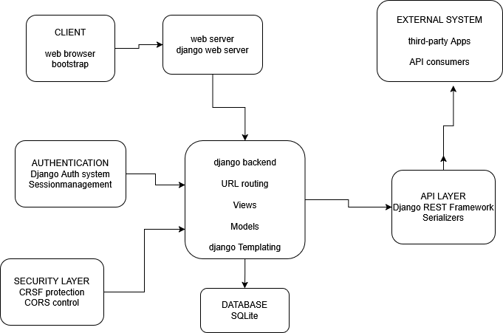
System Architecture

Slide 5
cont
Frontend: Django Templates + Bootstrap 5
Backend: Django Views, Django REST Framework
Database: SQLite
Authentication: Django Session Authentication
Configuration: Environment Variables via Python Decouple

Slide 6
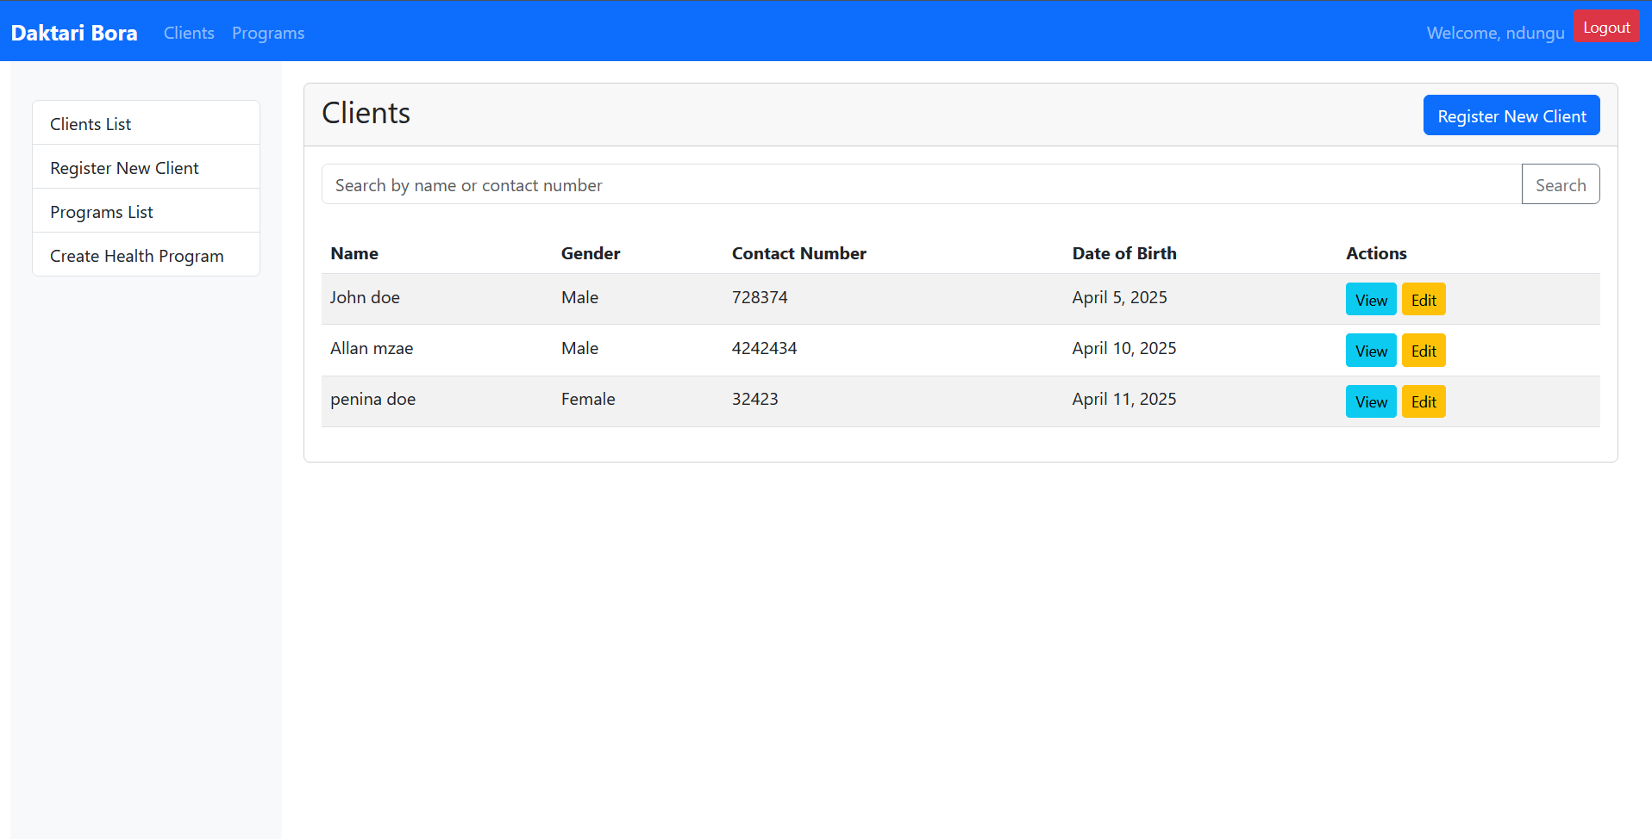
User Interface - Clients

Slide 7
cont
Register new clients
View client information
Search client
Access client profiles

Slide 8
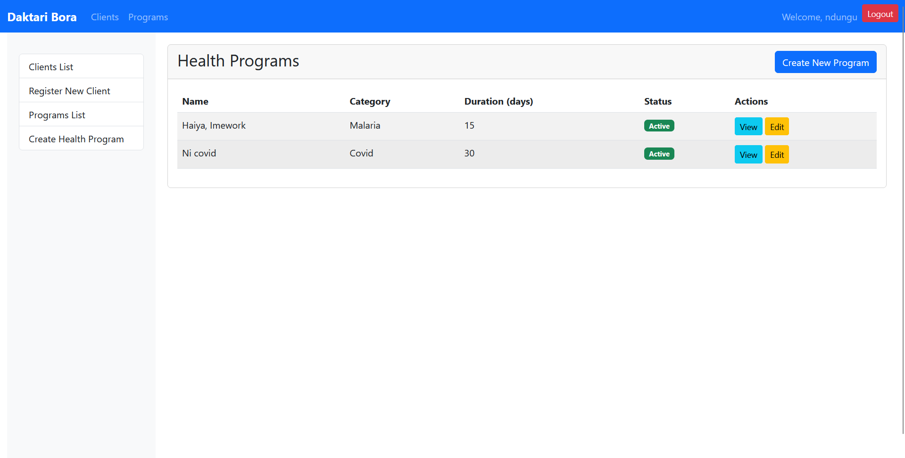
User Interface - Programs

Slide 9
cont
Create health programs
View program details
Manage program enrollments

Slide 10
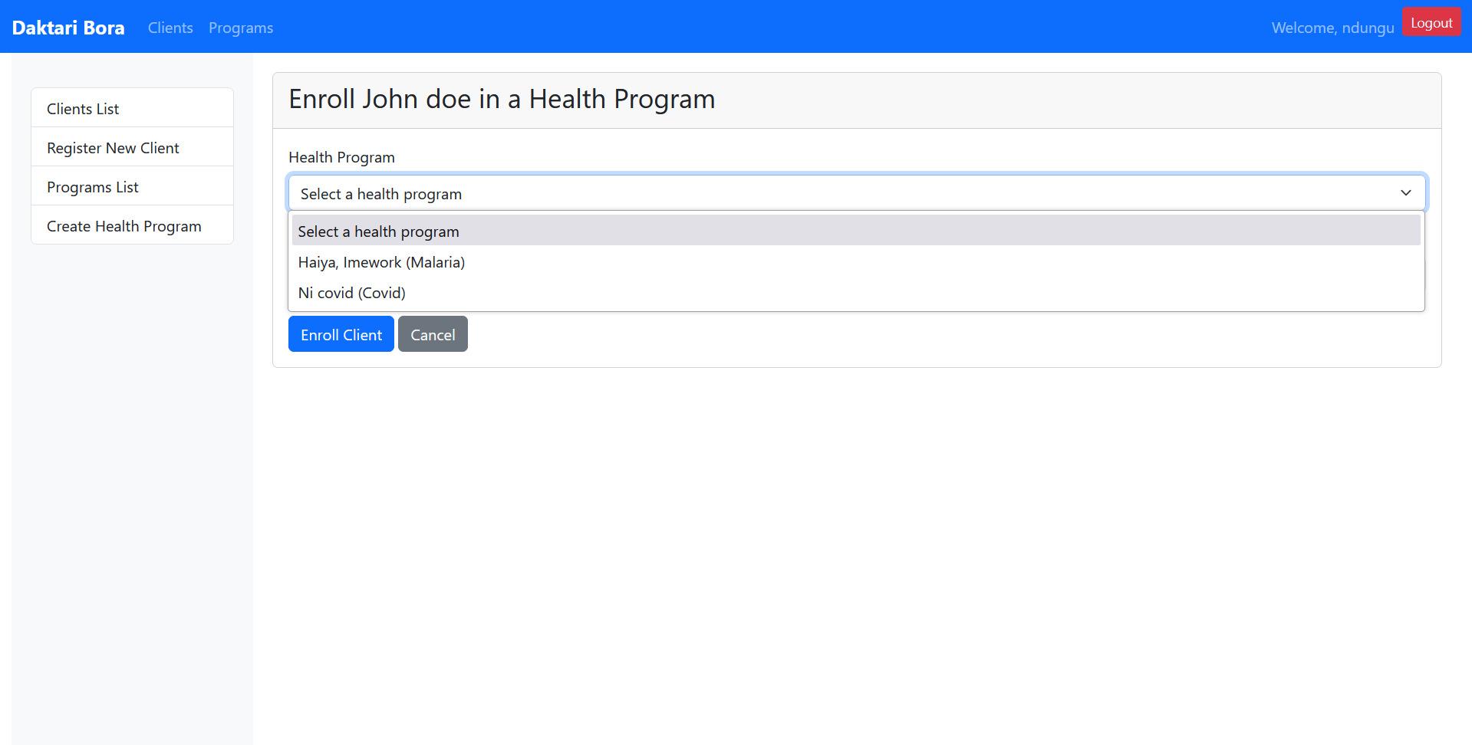
User Interface - Enrollment

Slide 11
cont
Enroll clients in programs
Change enrollment status
View enrollment history

Slide 12
Setup Instructions
Clone repository
Install dependencies: pip install -r requirements.txt
Set environment variables (.env file)
Apply migrations: python manage.py migrate
Create superuser: python manage.py createsuperuser
Start server: python manage.py runserver

Slide 13
Usage Flow
Login
Register if not registered
Add Programs in Programs section
Register Clients in Clients section
Enroll Clients into Programs
View Client Profiles with enrollment status
Access APIs for system integration

Slide 14
Deployment Architecture
Hosting Provider: Render
Live Demo URL: https://daktari-bora-wv0m.onrender.com
Service Type: Web Service
Environment: Production

Slide 15
Contact
THANK YOU!
Contact Information:
John Ndungu Kimotho
ndungukimotho15@gmail.com
Github: https://github.com/Ndungu-Jn/Daktari_bora
Daktari bora Application:
: https://daktari-bora-wv0m.onrender.com

